Slide 1
Troponin results updated

Slide 2

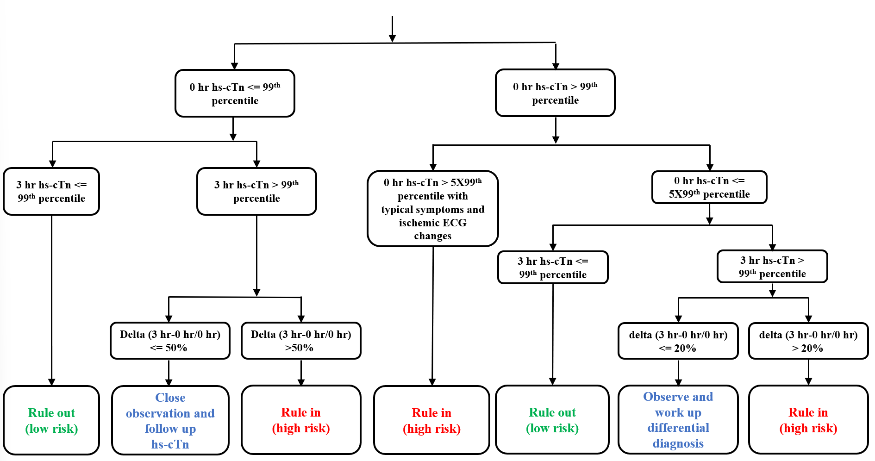
N=127
N=28
N=99
N=44
N=1
N=43
N=27
N=0
N=1
N=55
N=1
N=38
N=5

Slide 3

N=127
N=53
N=74
N=42
N=3
N=39
N=50
N=0
N=3
N=32
N=3
N=23
N=16

Slide 4

N=127
N=53
N=74
N=44
N=2
N=43
N=51
N=0
N=2
N=30
N=1
N=29
N=14

Slide 5

Total patients= 127
MI，n=11 (8.66%)
Non-MI，n=116 (91.34%)
Calibration plot
Bland-Altman plot
y = 0.9776x + 1.1151 R² = 0.9999
Bias(3.25)
95% Limits of agreement
(-30.1 to 36.6)
Notes:
subcohort 剩餘檢體的分析
首先bland plot 誤差為~~在~~
再來calibration plot 兩者之R平方接近於1
證明檢體的品質在可接受範圍

Slide 6
Roche (LoB=3 ng/L) | 99th % URL (ng/L) |  | Roche | Rule-out N=28 |  | Observe N=38 |  | Rule-in N=61
Overall | 14 |  | Prevalence | MI | Non-MI | MI | Non-MI | MI | Non-MI
 |  |  | 8.66% | 0 (0.0 %) | 28 (100 %) | 0 (0%) | 38 (100%) | 11 (18.03%) | 50 (81.97%)
Abbott (LoB=1.3 ng/L) | 99th % URL (ng/L) |  | Abbott | Rule-out N=53 |  | Observe N=23 |  | Rule-in N=51
Overall | 26 |  | Prevalence | MI | Non-MI | MI | Non-MI | MI | Non-MI
 |  |  | 8.66% | 0 (0.0%) | 53 (100%) | 1 (4.35%) | 22 (95.65%) | 10 (19.61%) | 41 (80.39%)
Beckman (LoB=1.3 ng/L) | 99th % URL (ng/L) |  | Beckman | Rule-out N=52 |  | Observe N=29 |  | Rule-in N=46
Overall | 17.5 |  | Prevalence | MI | Non-MI | MI | Non-MI | MI | Non-MI
 |  |  | 8.66% | 0 (0.0%) | 52 (100%) | 1 (3.45%) | 28 (96.55%) | 10 (21.74%) | 36 (78.26%)
Notes:
ER要的是NPV CV要的是PPV, 藉由調整cutoff讓CV信服

Slide 7
Roche (LoB=3 ng/L) | 99th % URL (ng/L) |  | Roche | Rule-out | Rule-in
Overall | 14 |  | Prevalence | 28 (MI=0) | 61 (MI=11)
 |  |  | 8.66% | NPV=100% | PPV=18.03%
Notes:
ER要的是NPV CV要的是PPV, 藉由調整cutoff讓CV信服

Slide 8
Abbott (LoB=1.3 ng/L) | 99th % URL (ng/L) |  | Abbott | Rule-out | Rule-in
Overall | 26 |  | Prevalence | 53 (MI=0) | 51 (MI=10)
 |  |  | 8.66% | NPV=100% | PPV=19.61%
Notes:
ER要的是NPV CV要的是PPV, 藉由調整cutoff讓CV信服

Slide 9
Beckman (LoB=1.3 ng/L) | 99th % URL (ng/L) |  | Beckman | Rule-out | Rule-in
Overall | 17.5 |  | Prevalence | 52 (MI=0) | 46 (MI=10)
 |  |  | 8.66% | NPV=100% | PPV=21.74%
Notes:
ER要的是NPV CV要的是PPV, 藉由調整cutoff讓CV信服

Slide 10
0h: cut-off的調整
AUROC=0.73
Cut-off | Sensitivity | Specificity | LR(+) | LR(-) | PPV | NPV
>=10 | 0.9091 | 0.1638 | 1.0872 | 0.5550 | 0.093444 | 0.950015
>=20.3 | 0.8182 | 0.3276 | 1.2168 | 0.5550 | 0.103436 | 0.950015
>=41.4 | 0.8182 | 0.4828 | 1.5818 | 0.3766 | 0.130426 | 0.965529
>=68.6 | 0.7273 | 0.5776 | 1.7217 | 0.4722 | 0.140338 | 0.957155
>=80 | 0.7273 | 0.6466 | 2.0576 | 0.4218 | 0.163265 | 0.961552
>=101 | 0.7273 | 0.6983 | 2.4104 | 0.3906 | 0.186037 | 0.964297
>=121 | 0.6364 | 0.7328 | 2.3812 | 0.4963 | 0.184215 | 0.955071
>=140 | 0.6364 | 0.7931 | 3.0758 | 0.4585 | 0.225782 | 0.958344
>=160 | 0.6364 | 0.8362 | 3.8852 | 0.4349 | 0.269198 | 0.960406
>=188 | 0.6364 | 0.8707 | 4.9212 | 0.4176 | 0.318173 | 0.961915
>=209 | 0.5455 | 0.8707 | 4.2182 | 0.5221 | 0.285711 | 0.952843
Notes:
黃色是廠商建議的範圍
提升cutoff可增加+但-改變不大
報告中LR+可提Cutoff調到100仍然不夠, LR-有點怪, 怎麼會cufoff愈高反而表現愈好??, 可增加PPV NPV可以更直覺

Slide 11
▲3h: ▲cut-off的調整 (T=0>URL)
AUROC=0.76
▲(%) | Sensitivity | Specificity | LR(+) | LR(-) | PPV | NPV
>=10 | 0.7000 | 0.6404 | 1.9469 | 0.4684 | 0.155804 | 0.957474
>=23 | 0.6000 | 0.8090 | 3.1412 | 0.4944 | 0.229486 | 0.955221
>=42 | 0.6000 | 0.9101 | 6.6750 | 0.4395 | 0.387545 | 0.959997
>=60 | 0.5000 | 0.9438 | 8.9000 | 0.5298 | 0.457557 | 0.952174
>=89 | 0.4000 | 0.9775 | 17.8000 | 0.6138 | 0.627633 | 0.945005
>=109 | 0.4000 | 0.9888 | 35.6000 | 0.6068 | 0.772007 | 0.945599
>=136 | 0.3000 | 0.9888 | 26.7000 | 0.7080 | 0.71748 | 0.937102
Notes:
作R/I
T=0>URL and delta>20%

Slide 12
▲3h: ▲cut-off的調整 (T=0<URL)
AUROC=1.00
▲(%) | Sensitivity | Specificity | LR(+) | LR(-) | PPV | NPV
>=10 | 1.0000 | 0.5556 | 2.2500 | 0.0000 | 0.175832 | 1
>=21 | 1.0000 | 0.7778 | 4.5000 | 0.0000 | 0.299077 | 1
>=30 | 1.0000 | 0.9259 | 13.5000 | 0.0000 | 0.561306 | 1
>=37 | 1.0000 | 0.9630 | 27.0000 | 0.0000 | 0.719294 | 1
Notes:
作R/I
T=0<URL (delta>50%)

Slide 13
0h: cut-off的調整
AUROC=0.79
Cut-off | Sensitivity | Specificity | LR(+) | LR(-) | PPV | NPV
>=20.2 | 1.0000 | 0.4224 | 1.7313 | 0.0000 | 0.141001 | 1
>=30.8 | 0.8182 | 0.5172 | 1.6948 | 0.3515 | 0.138433 | 0.967748
>=40 | 0.8182 | 0.5948 | 2.0193 | 0.3057 | 0.160684 | 0.971837
>=63.4 | 0.8182 | 0.6466 | 2.3149 | 0.2812 | 0.179997 | 0.974035
>=83.5 | 0.7273 | 0.6897 | 2.3434 | 0.3955 | 0.181819 | 0.963867
>=103.6 | 0.5455 | 0.7328 | 2.0411 | 0.6203 | 0.16217 | 0.944462
>=123.5 | 0.5455 | 0.7672 | 2.3434 | 0.5924 | 0.181777 | 0.94682
>=149.4 | 0.5455 | 0.7759 | 2.4336 | 0.5859 | 0.187511 | 0.947385
>=175.7 | 0.5455 | 0.8103 | 2.8760 | 0.5609 | 0.21423 | 0.949506
>=209.8 | 0.4545 | 0.8103 | 2.3967 | 0.6731 | 0.185107 | 0.940002

Slide 14
▲3h: ▲cut-off的調整
(T=0>URL)
AUROC=0.60
▲(%) | Sensitivity | Specificity | LR(+) | LR(-) | PPV | NPV
>=11 | 0.6000 | 0.2813 | 0.8348 | 1.4222 | 0.073346 | 0.881199
>=21 | 0.6000 | 0.5156 | 1.2387 | 0.7758 | 0.105095 | 0.931486
>=38 | 0.6000 | 0.6563 | 1.7455 | 0.6095 | 0.142008 | 0.945372
>=63 | 0.6000 | 0.7656 | 2.5600 | 0.5224 | 0.195294 | 0.952803
>=85 | 0.5000 | 0.8125 | 2.6667 | 0.6154 | 0.201806 | 0.944871
>=104 | 0.5000 | 0.8750 | 4.0000 | 0.5714 | 0.274964 | 0.948607
>=154 | 0.5000 | 0.9063 | 5.3333 | 0.5517 | 0.335957 | 0.950294
>=181 | 0.4000 | 0.9219 | 5.1200 | 0.6508 | 0.326865 | 0.941881
>=269 | 0.3000 | 0.9375 | 4.8000 | 0.7467 | 0.312758 | 0.933888
Notes:
T=0>URL and delta>20%

Slide 15
▲3h: ▲cut-off的調整
(T=0<URL)
AUROC=1.00
▲(%) | Sensitivity | Specificity | LR(+) | LR(-) | PPV | NPV
>=10 | 1.0000 | 0.3269 | 1.4857 | 0.0000 | 0.123466 | 1
>=21 | 1.0000 | 0.5962 | 2.4762 | 0.0000 | 0.19015 | 1
>=34 | 1.0000 | 0.7308 | 3.7143 | 0.0000 | 0.260461 | 1
>=50 | 1.0000 | 0.7500 | 4.0000 | 0.0000 | 0.274964 | 1
>=64 | 1.0000 | 0.8269 | 5.7778 | 0.0000 | 0.353889 | 1
>=93 | 1.0000 | 0.9038 | 10.4000 | 0.0000 | 0.496363 | 1
>=117 | 1.0000 | 0.9231 | 13.0000 | 0.0000 | 0.552153 | 1
Notes:
T=0<URL and delta>50%

Slide 16
0h: cut-off的調整
AUROC=0.76
Cut-off | Sensitivity | Specificity | LR(+) | LR(-) | PPV | NPV
>=10.18 | 0.9091 | 0.3707 | 1.4446 | 0.2452 | 0.120466 | 0.97728
>=20.92 | 0.9091 | 0.4914 | 1.7874 | 0.1850 | 0.144912 | 0.982764
>=30.54 | 0.8182 | 0.6207 | 2.1570 | 0.2929 | 0.169793 | 0.972981
>=44.21 | 0.8182 | 0.6810 | 2.5651 | 0.2670 | 0.19561 | 0.975314
>=50.69 | 0.7273 | 0.6983 | 2.4104 | 0.3906 | 0.186037 | 0.964297
>=58.07 | 0.7273 | 0.7414 | 2.8121 | 0.3679 | 0.210516 | 0.966302
>=70.79 | 0.6364 | 0.7500 | 2.5455 | 0.4848 | 0.194425 | 0.956056
>=81.21 | 0.5455 | 0.7586 | 2.2597 | 0.5992 | 0.176444 | 0.946249
>=92.92 | 0.4545 | 0.7845 | 2.1091 | 0.6953 | 0.166639 | 0.938151
>=100.7 | 0.4545 | 0.7931 | 2.1970 | 0.6877 | 0.172372 | 0.938781
>=118.6 | 0.3636 | 0.8103 | 1.9174 | 0.7853 | 0.153779 | 0.930697

Slide 17
▲3h: ▲cut-off的調整
(T=0>URL)
AUROC=0.63
▲(%) | Sensitivity | Specificity | LR(+) | LR(-) | PPV | NPV
>=11 | 0.6000 | 0.3750 | 0.9600 | 1.0667 | 0.083425 | 0.908157
>=21 | 0.6000 | 0.6094 | 1.5360 | 0.6564 | 0.127124 | 0.941414
>=37 | 0.6000 | 0.7188 | 2.1333 | 0.5565 | 0.16826 | 0.949884
>=46 | 0.6000 | 0.7344 | 2.2588 | 0.5447 | 0.176399 | 0.950896
>=55 | 0.6000 | 0.7813 | 2.7429 | 0.5120 | 0.206419 | 0.953707
>=67 | 0.6000 | 0.8125 | 3.2000 | 0.4923 | 0.232772 | 0.955406
>=74 | 0.6000 | 0.8438 | 3.8400 | 0.4741 | 0.266964 | 0.956989
>=90 | 0.6000 | 0.8594 | 4.2667 | 0.4655 | 0.288052 | 0.957736
>=101 | 0.6000 | 0.8750 | 4.8000 | 0.4571 | 0.312758 | 0.958459
Notes:
T=0>URL and delta>20%

Slide 18
▲3h: ▲cut-off的調整
(T=0<URL)
AUROC=1.00
▲(%) | Sensitivity | Specificity | LR(+) | LR(-) | PPV | NPV
>=10 | 1.0000 | 0.4231 | 1.7333 | 0.0000 | 0.141148 | 1
>=21 | 1.0000 | 0.6731 | 3.0588 | 0.0000 | 0.224824 | 1
>=29 | 1.0000 | 0.8077 | 5.2000 | 0.0000 | 0.330223 | 1
>=43 | 1.0000 | 0.8846 | 8.6667 | 0.0000 | 0.451027 | 1
>=62 | 1.0000 | 0.9231 | 13.0000 | 0.0000 | 0.552153 | 1
>=96 | 1.0000 | 0.9808 | 51.9999 | 0.0000 | 0.831595 | 1
Notes:
T=0<URL and delta>50%

Slide 19
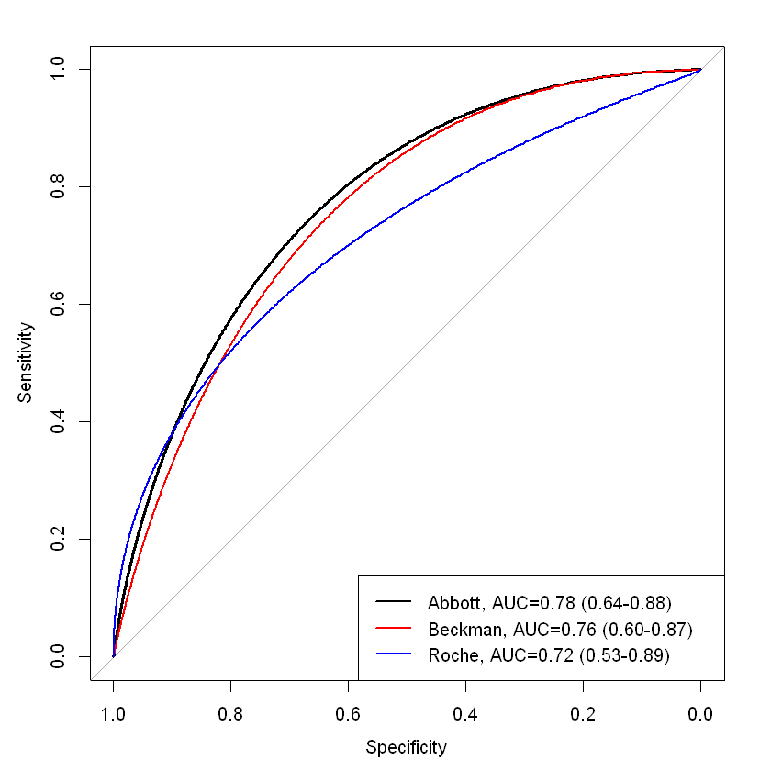
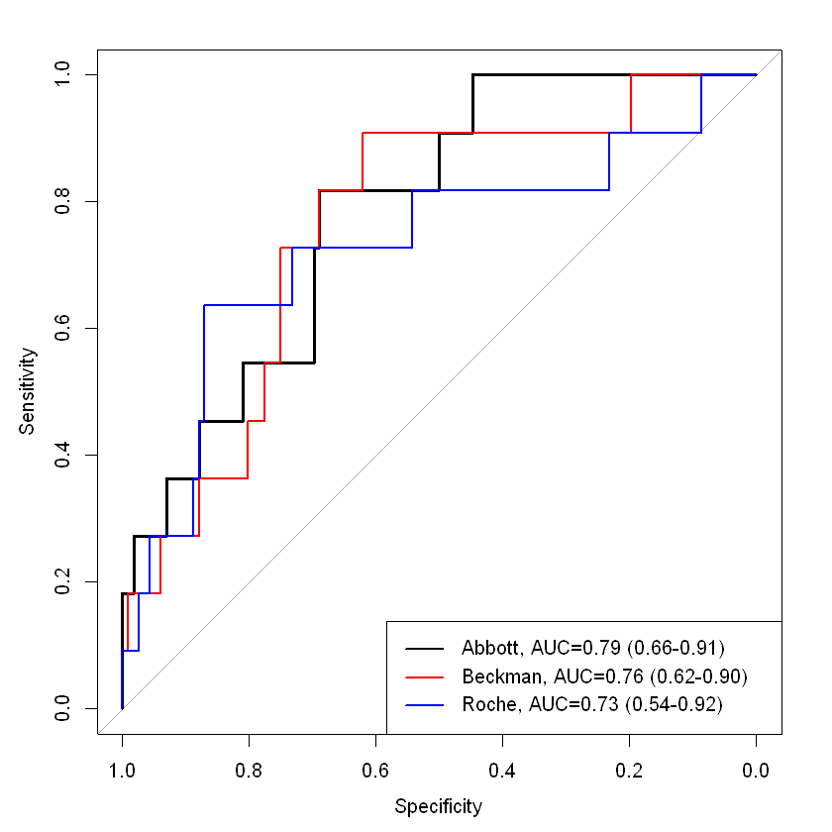
Comparison:AUROC(T0>URL)
T0
T0
T0
3h
Notes:
做成SMOOTH, 確認定義是T=0正常, T=3的delta的比較
CGRD 的曲線資料來源??
為何AUROC R=0 Abbott/Beckman都比Roche好但是Abbott/Beckman單看cutoff表現卻大輸給Roche

Slide 20
Roche (LoB=3 ng/L) | 99th % URL (ng/L)
Overall (age <70) | 14
Age > 70 | 54
Specific cutoffs-Age
Roche | Rule-out | Rule-in
Prevalence | 28 (MI=0) | 61 (MI=11)
8.66% (11/127) | NPV=100% | PPV=18.03%
 | Roche | Rule-out | Rule-in
Age <70 | Prevalence | 18 (MI=0) | 29 (MI=8)
 | 13.79% (8/58) | NPV=100% | PPV=27.59%
Age > 70 | 4.35% (3/69) | 34 (MI=0) | 13 (MI=3)
 |  | NPV=100% | PPV=23.08%
Notes:
將cut-off調到54
可以看到不影響NPV卻可以提升7%的PPV
prevalence的定義是? 怎麼會老人的preva.反而比較低? 另外subgroup的PPV沒有KEY到

Slide 21
Abbott (LoB=1.3 ng/L) | 99th % URL (ng/L)
Overall (age <70) | 26
Age > 70 | 32
Specific cutoffs-Age
Abbott | Rule-out | Rule-in
Prevalence | 53 (MI=0) | 48 (MI=9)
8.66% (11/127) | NPV=100% | PPV=18.75%
 | Abbott | Rule-out | Rule-in
Age <70 | Prevalence | 24 (MI=0) | 21 (MI=6)
 | 13.79% (8/58) | NPV=100% | PPV=28.57%
Age > 70 | 4.35% (3/69) | 33 (MI=0) | 27 (MI=3)
 |  | NPV=100% | PPV=11.11%

Slide 22
Beckman (LoB=1.3 ng/L) | 99th % URL (ng/L)
Overall (age <70) | 17.5
Age > 70 | 54
Specific cutoffs-Age
Beckman | Rule-out | Rule-in
Prevalence | 52 (MI=0) | 44 (MI=9)
8.66% (11/127) | NPV=100% | PPV=20.45%
 | Beckman | Rule-out | Rule-in
Age <70 | Prevalence | 24 (MI=0) | 21 (MI=6)
 | 13.79% (8/58) | NPV=100% | PPV=28.57%
Age > 70 | 4.35% (3/69) | 47 (MI=0) | 17 (MI=3)
 |  | NPV=100% | PPV=17.65%

Slide 23
Roche (LoB=3 ng/L) | 99th % URL (ng/L)
Overall | 14
Female | 11
Male | 16
Specific cutoffs-Gender
 | Roche | Rule-out | Rule-in
Overall | Prevalence | 28 (MI=0) | 61 (MI=11)
 | 8.66% (11/127) | NPV=100% | PPV=18.03%
Female | 3.57% (2/56) | 14 (MI=0) | 22 (MI=2)
 |  | NPV=100% | PPV=9.09%
Male | 12.68% (9/71) | 14 (MI=0) | 37 (MI=9)
 |  | NPV=100% | PPV=24.32%
Notes:
cutoff的出處

Slide 24
Abbott (LoB=3 ng/L) | 99th % URL (ng/L)
Overall | 26
Female | 16
Male | 34
Specific cutoffs-Gender
 | Abbott | Rule-out | Rule-in
Overall | Prevalence | 53 (MI=0) | 48 (MI=9)
 | 8.66% (11/127) | NPV=100% | PPV=18.75%
Female | 3.57% (2/56) | 21 (MI=0) | 23 (MI=2)
 |  | NPV=100% | PPV=8.70%
Male | 12.68% (9/71) | 27 (MI=0) | 32 (MI=8)
 |  | NPV=100% | PPV=25%

Slide 25
Beckman (LoB=3 ng/L) | 99th % URL (ng/L)
Overall | 26
Female | 11.6
Male | 19.8
Specific cutoffs-Gender
 | Beckman | Rule-out | Rule-in
Overall | Prevalence | 52 (MI=0) | 44 (MI=9)
 | 8.66% (11/127) | NPV=100% | PPV=20.45%
Female | 3.57% (2/56) | 24 (MI=0) | 19 (MI=2)
 |  | NPV=100% | PV=10.53%
Male | 12.68% (9/71) | 24 (MI=0) | 27 (MI=8)
 |  | NPV=100% | PPV=29.63%

Slide 26
Specific cutoffs-Renal dysfunc.
Roche (LoB=3 ng/L) | 99th % URL (ng/L)
Overall | 14
eGFR<60 | 29.5
Roche | Rule-out | Rule-in
Prevalence | 28 (MI=0) | 61 (MI=11)
8.66% (11/127) | NPV=100% | PPV=18.03%
 | Roche | Rule-out | Rule-in
eGFR <60 | Prevalence | 20 (MI=0) | 28 (MI=6)
 | 7.50% (6/80) | NPV=100% | PPV=21.43%

Slide 27
Specific cutoffs-Renal dysfunc.
Abbott (LoB=3 ng/L) | 99th % URL (ng/L)
Overall | 26
eGFR<60 | 29.4
Abbott | Rule-out | Rule-in
Prevalence | 53 (MI=0) | 48 (MI=9)
8.66% (11/127) | NPV=100% | PPV=18.75%
 | Abbott | Rule-out | Rule-in
eGFR <60 | Prevalence | 27 (MI=0) | 33 (MI=5)
 | 7.50% (6/80) | NPV=100% | PPV=15.15%

Slide 28
Specific cutoffs-Renal dysfunc.
Beckman (LoB=3 ng/L) | 99th % URL (ng/L)
Overall | 17.5
eGFR<60 | 25.9
Beckman | Rule-out | Rule-in
Prevalence | 52 (MI=0) | 44 (MI=9)
8.66% (11/127) | NPV=100% | PPV=20.45%
 | Beckman | Rule-out | Rule-in
eGFR <60 | Prevalence | 34 (MI=0) | 25 (MI=4)
 | 7.50% (6/80) | NPV=100% | PPV=16%

Slide 29
 |  | Overall |  | Adjust for confounders
 |  | AUC (95% CI) | P-value | AUC (95% CI) | P-value
 | T0 | 0.73 (0.54-0.92) | (ref.) |  | (ref.)
 | 3H(▲%)&T=0>URL | 0.76 (0.56-0.97)
 | 3H (▲%)&T=0<URL | 1.00 (1.00-1.00)
 | T0 | 0.79 (0.66-0.91)
 | 3H (▲%)&T=0>URL | 0.60 (0.32-0.87)
 | 3H (▲%)&T=0<URL | 1.00 (1.00-1.00)
 | T0 | 0.76 (0.62-0.90)
 | 3H (▲%)&T=0>URL | 0.63 (0.36-0.90)
 | 3H (▲%)&T=0<URL | 1.00 (1.00-1.00)
Adjusted AUC
Notes:
3H 20%是否為T=0> ULR下3H的delta變化
3H 50%是否為T=0< ULR下3H的delta變化

Slide 30
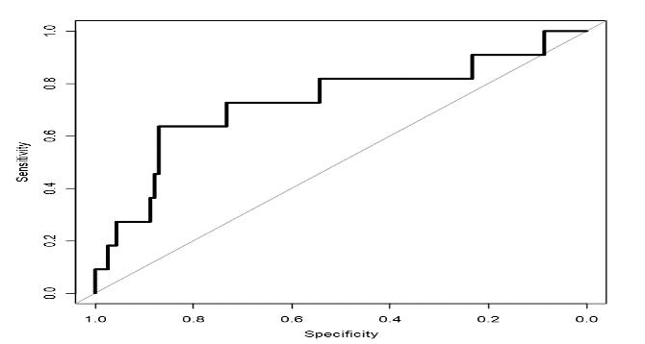
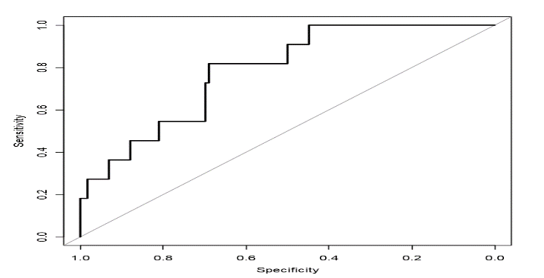
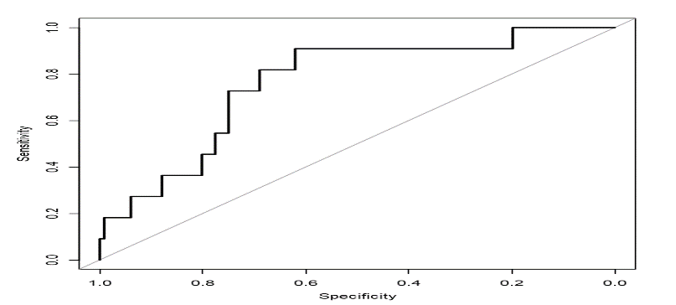
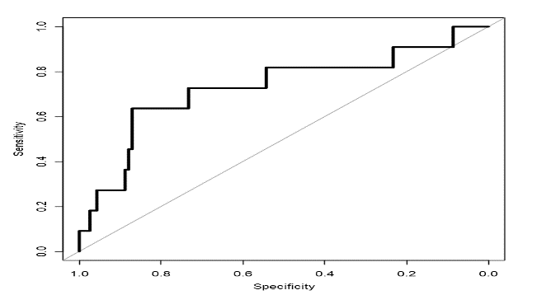
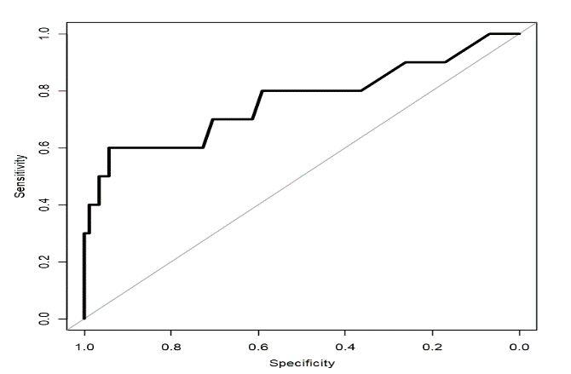
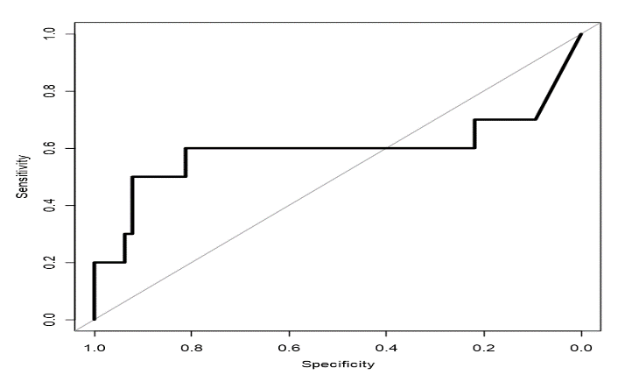
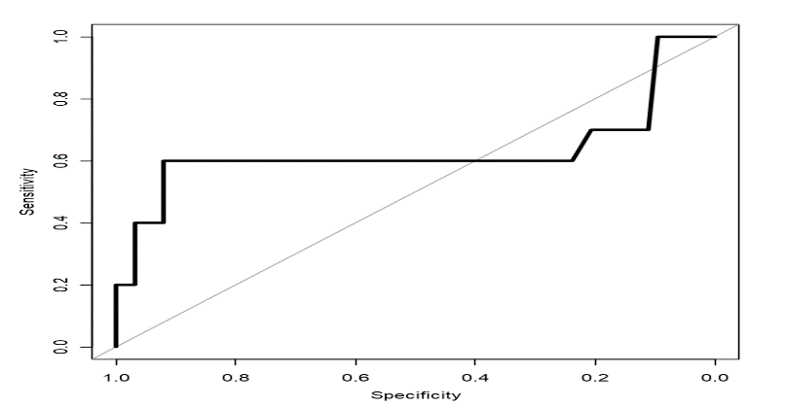
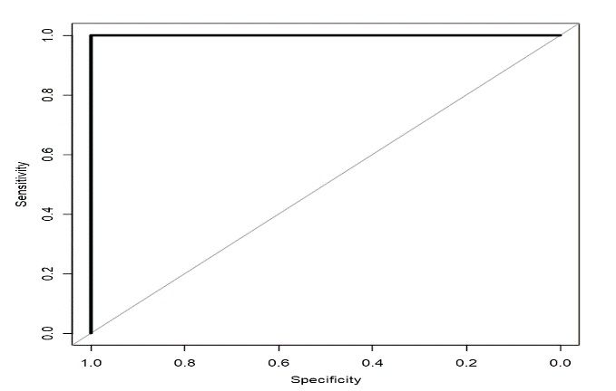
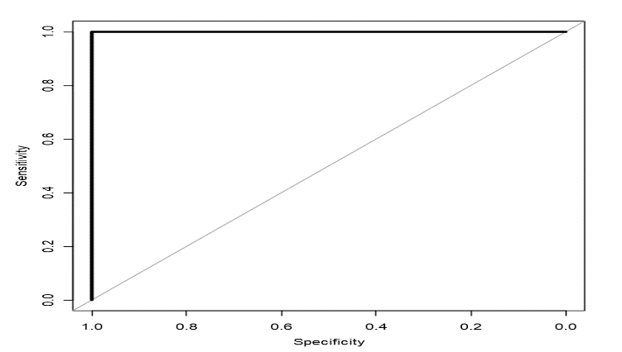

Roche T=0
0.73 (0.54-0.92)
Abbott T=0
0.79 (0.66-0.91)
Beckman T=0
0.76 (0.62-0.90)
Roche T=0 > URL
0.76 (0.56-0.97)
Abbott T=0 > URL
0.60 (0.32-0.87)
Beckman T=0 > URL
0.63 (0.36-0.90)
Roche T=0 < URL
1.00 (1.00-1.00)
Abbott T=0 < URL
1.00 (1.00-1.00)
Beckman T=0 < URL
1.00 (1.00-1.00)
Notes:
Cutoff ROC

Slide 31
 | Overall | Non-MI | MI | P-value
n | 127 | 116 | 11
age (median [IQR]) | 71.30 (14.78) | 71.78 (14.81) | 66.18 (14.03) | 0.231
male = 1 (%) | 71 (55.9) | 62 (53.4) | 9 ( 81.8) | 0.135
GFR (median [IQR]) | 56.39 (62.82) | 57.65 (64.63) | 43.13 (38.26) | 0.466
renal_dysfunction = 1 (%) | 80 (63.0) | 74 (63.8) | 6 ( 54.5) | 0.779
Creatinine (median [IQR]) | 2.70 (3.07) | 2.54 (2.93) | 4.36 (4.13) | 0.060
有無住院 = 1 (%) | 74 (58.3) | 63 (54.3) | 11 (100.0) | 0.009
有無入住心臟科病房 = 1 (%) | 26 (20.5) | 16 (13.8) | 10 ( 90.9) | <0.001
是否有心導管 = 1 (%) | 13 (10.2) | 4 ( 3.4) | 9 ( 81.8) | <0.001

Slide 32
0 hr hs-cTn <= 99th percentile
0 hr hs-cTn > 99th percentile
3 hr hs-cTn <= 99th percentile
3 hr hs-cTn > 99th percentile
0 hr hs-cTn > 5X99th percentile with typical symptoms and ischemic ECG changes
0 hr hs-cTn <= 5X99th percentile and 3 hr hs-cTn > 99th percentile
Delta (3 hr-0 hr/0 hr) <= 50%
Delta (3 hr-0 hr/0 hr) >50%
delta (3 hr-0 hr/0 hr) <= 20%
delta (3 hr-0 hr/0 hr) > 20%
Rule out
(low risk)
Close observation and
follow up hs-cTn
Rule in
(high risk)
Rule in
(high risk)
Observe and work up differential diagnosis
Rule in
(high risk)
Figure 2. The 0h/3h rapid diagnosis protocol with hs-cTn assay.
Note: ACS: acute coronary syndrome; ECG: electrocardiogram; hs-cTn: High Sensitivity Cardiac Troponin.

